Slide 1
Software engineering (Undergraduate)
Chapter 1 software & software engineering
Course Name software engineering
CSC 3114
(Undergraduate)
Md Raihan MAhmud
Lecturer, CS, AIUB

Slide 2
Why system fails?
Slide - 2
The system fails to meet the business requirements for which it was developed. The system is either abandoned or expensive adaptive maintenance is undertaken.
There are performance shortcomings in the system, which make it inadequate for the users’ needs. Again, it is either abandoned or amended incurring extra costs.
Errors appear in the developed system causing unexpected problems. Patches have to be applied at extra cost.
Users reject the implemented system, lack of involvement in its development or lack of commitment to it.
Systems are initially accepted but over time become un-maintainable and so pass into disuse.

Slide 3
Scope of software Engineering
Slide - 3
The aim of Software Engineering is to solve Software Crisis:
Late
Over budget
Low quality with lots of faults
Software crisis is still present over 35 years later!

Slide 4
Software characteristics
Slide - 4
A logical (intangible) rather than a physical system element
Being developed or engineered but not being manufactured
Software cost concentrating in engineering, not in materials
Software does not “wearing out” but “deteriorating”(not destroyed after lifetime like hardware, but backdated by aging that needs to update)
Software is a ‘differentiator’ (different sub-systems, e.g. cashier’s workstation in a supermarket)
Without “spare parts” in software maintenance (no extra useless features in software)
Most software continues to be custom-built (based on the requirements)

Slide 5
Goal: Computer science vs. Software engineering
Slide - 5
CS: to investigate a variety of ways to produce software, some good and some bad
SE: to be interested in only those techniques that make sound economic sense

Slide 6
Software development life cycle (SDLC)
Slide - 6
A structured set of activities required to develop a software system
The way we produce software, including:
Requirements Analysis
Designing/Modeling
Coding /Development
Testing
Implementation/Integration phase
Operation/Maintenance
Documentation

Slide 7
Good & bad software
Slide - 7
Good software is maintained—bad software is discarded
Different types of maintenance
Corrective maintenance [about 20%]
Modification to fix a problem
Enhancement [about 80%]
Perfective maintenance (modification to improve usability,…) [about 60%]
Adaptive maintenance (modification to keep up-to-date) [about 20%]
Preventive maintenance (modification to avoid any future error) [about 20%]

Slide 8
Faults in software development phases
Slide - 8
60 to 70 percent of faults are specification and design faults
Data of Kelly, Sherif, and Hops [1992]
1.9 faults per page of specification
0.9 faults per page of design
0.3 faults per page of code
Data of Bhandari et al. [1994]
Faults at end of the design phase of the new version of the product
13% of faults from previous version of product
16% of faults in new specifications
71% of faults in new design

Slide 9
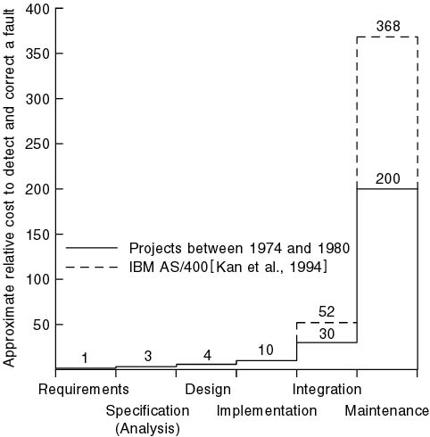
Cost of detection & correction of a fault
Slide - 9

Slide 10
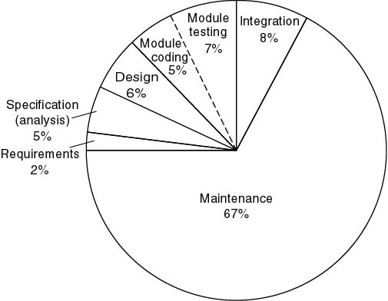
Cost of detection & correction of a fault
Slide - 10

Slide 11
Cost of change
Slide - 11

Slide 12
Product bathtub curve model
Slide - 12
“Infant Mortality/Early Failure Period” --
due to design or
manufacturing defects
Failure Rate
“Wear-out” --
due to cumulative
affects of environments
“Useful Life Period"
Time
Notes:
Infant Mortality: The infant mortality section is simply referred to as the early failure period. Failures usually occur due to manufacturing defects, installation issues, design issues, material defects, improper start-up procedures, etc.
Wear-out: The Wear-out section is also known as the aging period. This period simply represents the end of an asset's life cycle.

Slide 13
Software actual failure curve
Slide - 13
Increased failure rates
due to side effects
Failure Rate
Actual Curve
Change
Idealized Curve
Time
Notes:
Early high failure rate: When software is first released, it often has many undetected bugs, leading to a high initial failure rate.
Rapid decline: As developers identify and fix these bugs, the failure rate quickly drops to a low level.
Stable phase: Once most critical bugs are addressed, the software reaches a relatively stable state with a low and constant failure rate.

Slide 14
what is Software engineering?
Slide - 14
Technologies that make it easier, faster, and less expensive to build high-quality computer programs
A discipline aiming to the production of fault-free software, delivered on time and within budget, that satisfies the users’ needs
An engineering: set of activities in software production
The philosophy and paradigm of established engineering disciplines to solve what are termed software crisis

Slide 15
Software application
Slide - 15
System software (control computer hardware such as OS)
Business software (commercial application for business users, SAP, ERP)
Engineering and scientific software (e.g. statistical analysis-SPSS, Matlab)
Embedded software (e.g. autopilot, biometric device)
Personal computer software (e.g. Microsoft Office)
Web-based software (use over the internet with a browser, e.g. Gmail)
Artificial intelligence software (interact with computer, HCI, ame)

Slide 16
Software Myths (management)
Slide - 16
Myth 1: We already have a book full of standards and procedures for building software. Wouldn’t that provide my people with everything they need to know?
Myth 2: My people have state-of-the-art software development tools; we buy them the newest computers.
Myth 3: If we get behind schedule, we can add more programmers and catch up.
Myth 4: If I outsource the software project to a third party, I can relax and let that firm build it.

Slide 17
Software Myths (customer)
Slide - 17
Myth 1: A general statement of objectives is sufficient to begin writing programs – we can fill in the details later.
Myth 2: Project requirements continually change, but change can be easily accommodated because software is flexible.

Slide 18
Software Myths (practitioner)
Slide - 18
Myth 1: Our job is done once we write the program and get it to work.
Fact: the sooner you begin writing code, the longer it will take you to get done.
Myth 2: I cannot assess the program's quality until it is “running. "
Myth 3: The working program is the only deliverable work product for a successful project.
Myth 4: Software engineering will make us create voluminous and unnecessary documentation, invariably slowing us down.

Slide 19
references
Slide - 19
R.S. Pressman & Associates, Inc. (2010). Software Engineering: A Practitioner’s Approach.
Kelly, J. C., Sherif, J. S., & Hops, J. (1992). An analysis of defect densities found during software inspections. Journal of Systems and Software, 17(2), 111-117.
Bhandari, I., Halliday, M. J., Chaar, J., Chillarege, R., Jones, K., Atkinson, J. S., & Yonezawa, M. (1994). In-process improvement through defect data interpretation. IBM Systems Journal, 33(1), 182-214.
SB

